Slide 1

Advanced Physics Lab Ⅱ
2020312141 Donghun Jung
2020311441 Yujin Chon
Raman Spectroscopy for

Slide 2
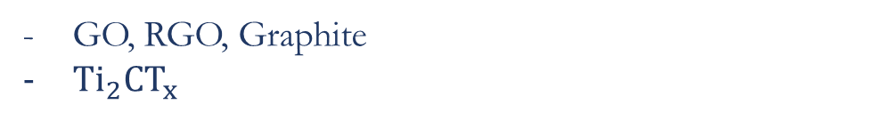
Outline
Outline
Introduction
/Theory
Raman Spectroscopy
Graphene Phonon Mode
Graphene Raman Spectrum
MXenes
Experiment
/Results
GO, RGO, Graphite
${Ti}_{2}CT_{x}$
Discussion
/Conclusion
Defects
Defects and Crystal Size
Conclusion

Slide 3
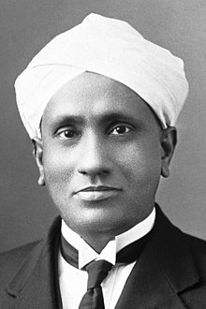
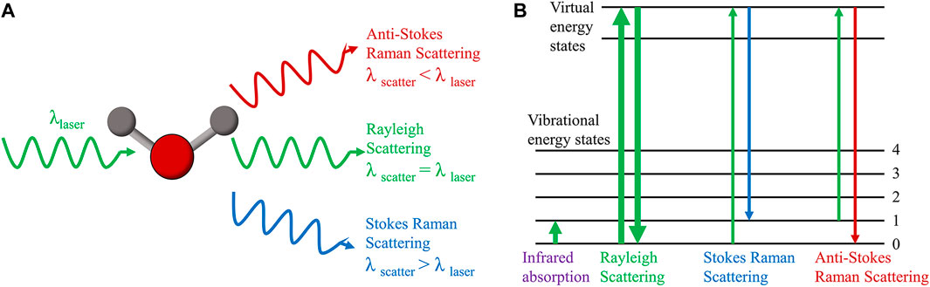
Raman Spectroscopy
Raman Shift
Raman scattering is inelastic photon scattering by matter. It is called Raman shift.

Slide 4
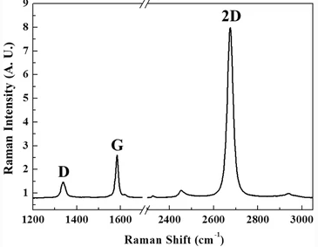


Raman Spectroscopy
Spectrometer
CCD

Slide 5
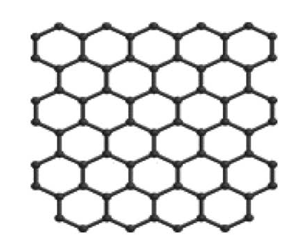
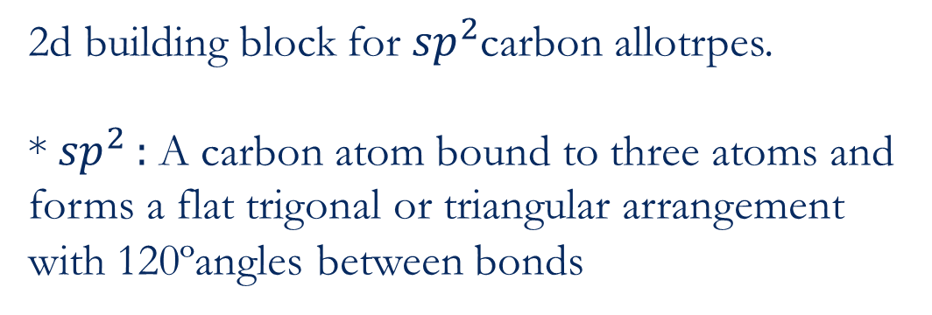
Graphene
2d building block for ${sp}^{2}$carbon allotrpes.
* ${sp}^{2}$ : A carbon atom bound to three atoms and forms a flat trigonal or triangular arrangement with 120ºangles between bonds

Slide 6
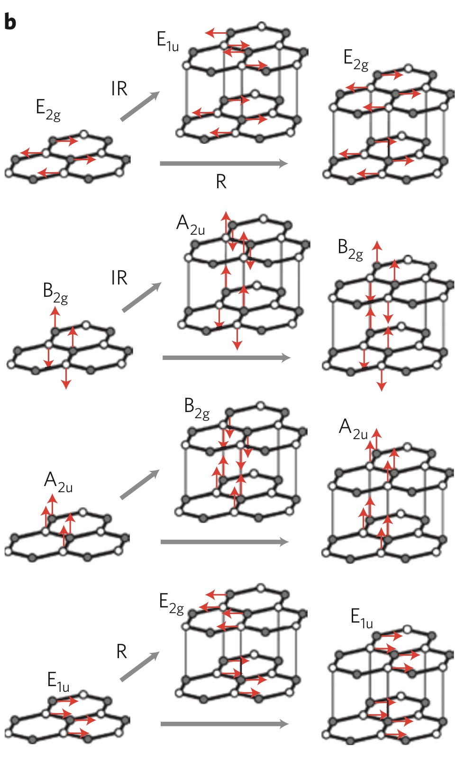
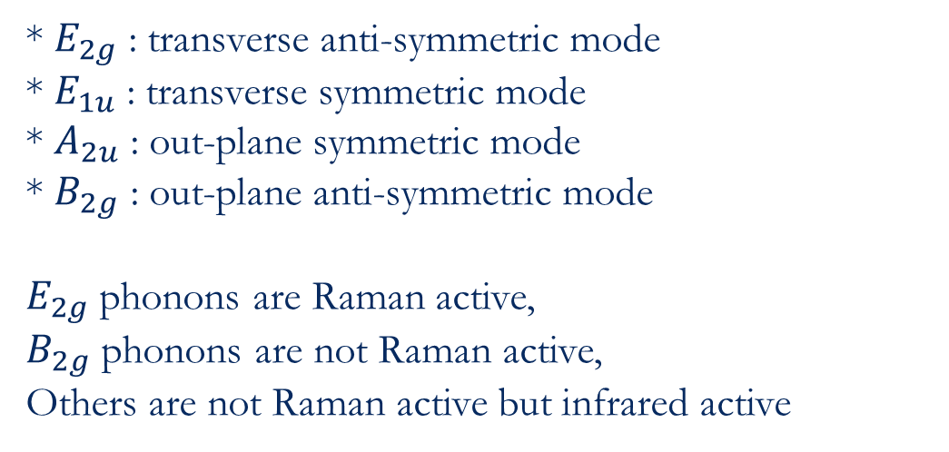
Graphene Phonon Normal Mode
* $E_{2g}$ : transverse anti-symmetric mode
* $E_{1u}$ : transverse symmetric mode
* $A_{2u}$ : out-plane symmetric mode
* $B_{2g}$ : out-plane anti-symmetric mode
$E_{2g}$ phonons are Raman active,
$B_{2g}$ phonons are not Raman active,
Others are not Raman active but infrared active

Slide 7
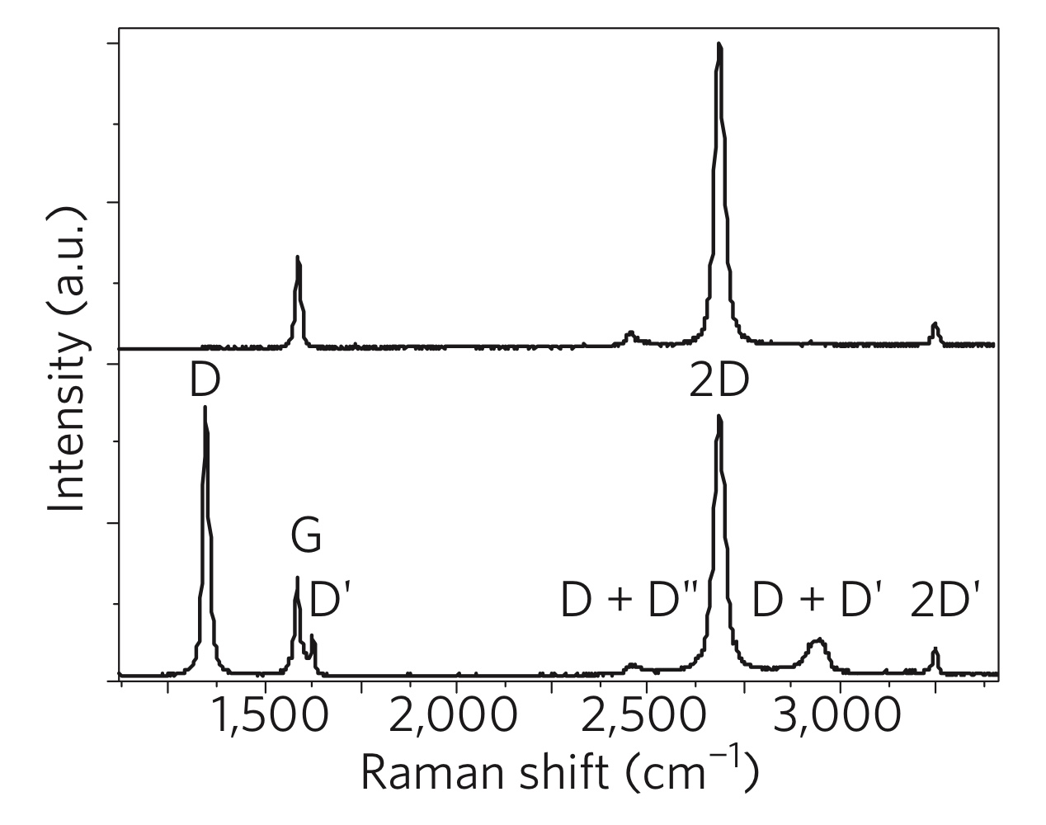
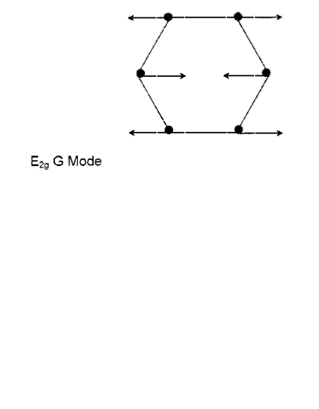
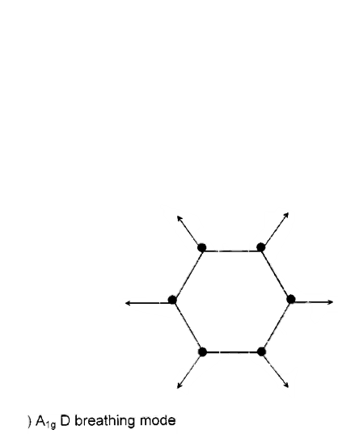
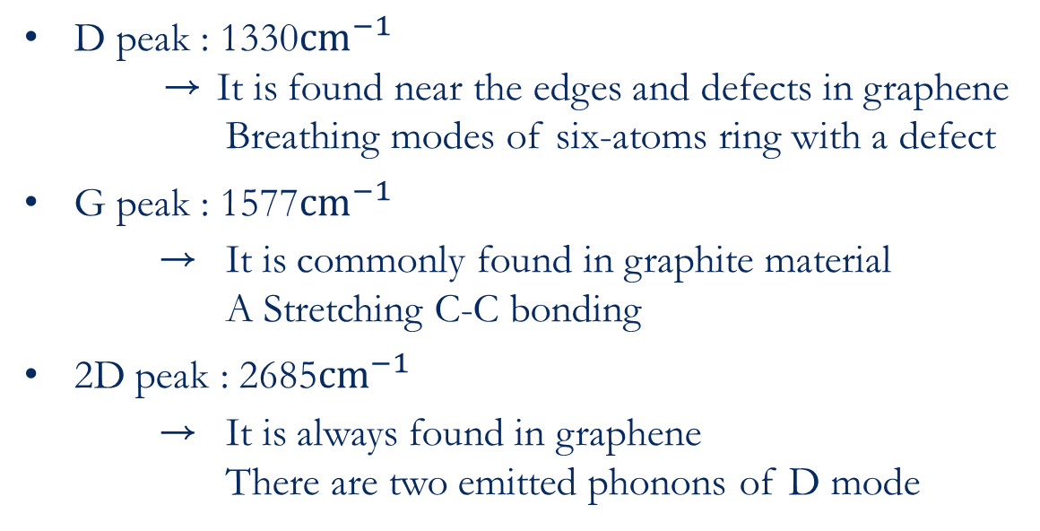
Graphene Raman Spectrum
D peak : 1330${cm}^{−1}$
→ It is found near the edges and defects in graphene
Breathing modes of six-atoms ring with a defect
G peak : 1577${cm}^{−1}$
→ It is commonly found in graphite material
A Stretching C-C bonding
2D peak : 2685${cm}^{−1}$
→ It is always found in graphene
There are two emitted phonons of D mode

Slide 8
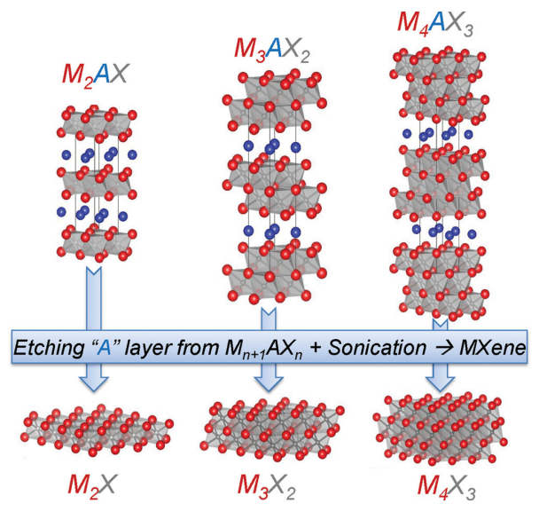
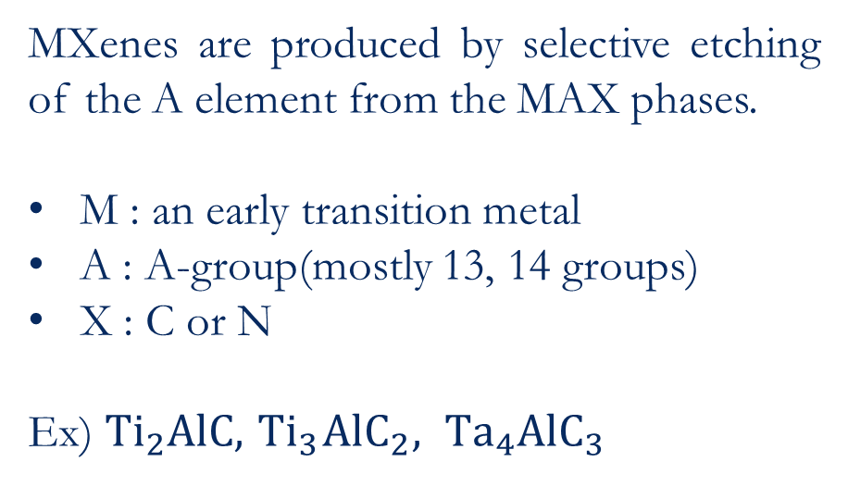
MXenes
MXenes are produced by selective etching of the A element from the MAX phases.
M : an early transition metal
A : A-group(mostly 13, 14 groups)
X : C or N
Ex) $Ti_{2}AlC, { Ti}_{3}{AlC}_{2}, {Ta}_{4}{AlC}_{3}$

Slide 9
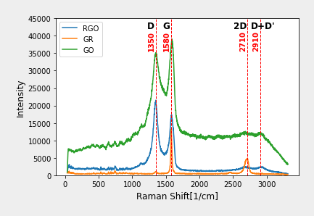
GO, RGO, Graphite – Experiment result

Slide 10
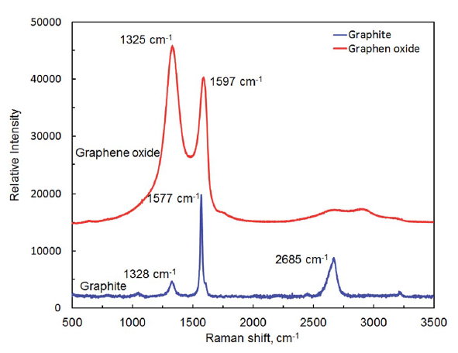
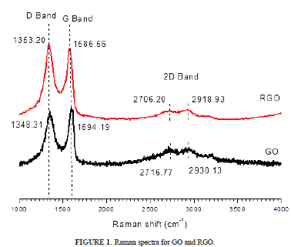
GO, RGO, Graphite

Slide 11
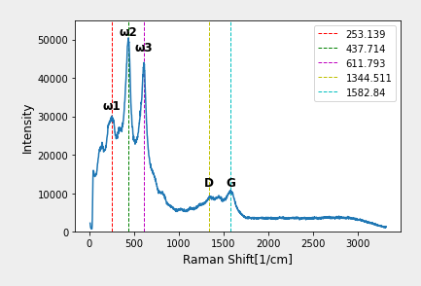
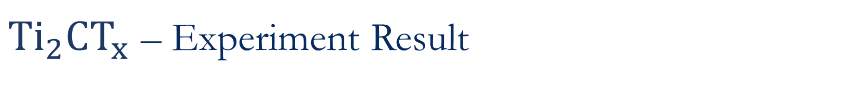
${Ti}_{2}CT_{x}$ – Experiment Result

Slide 12
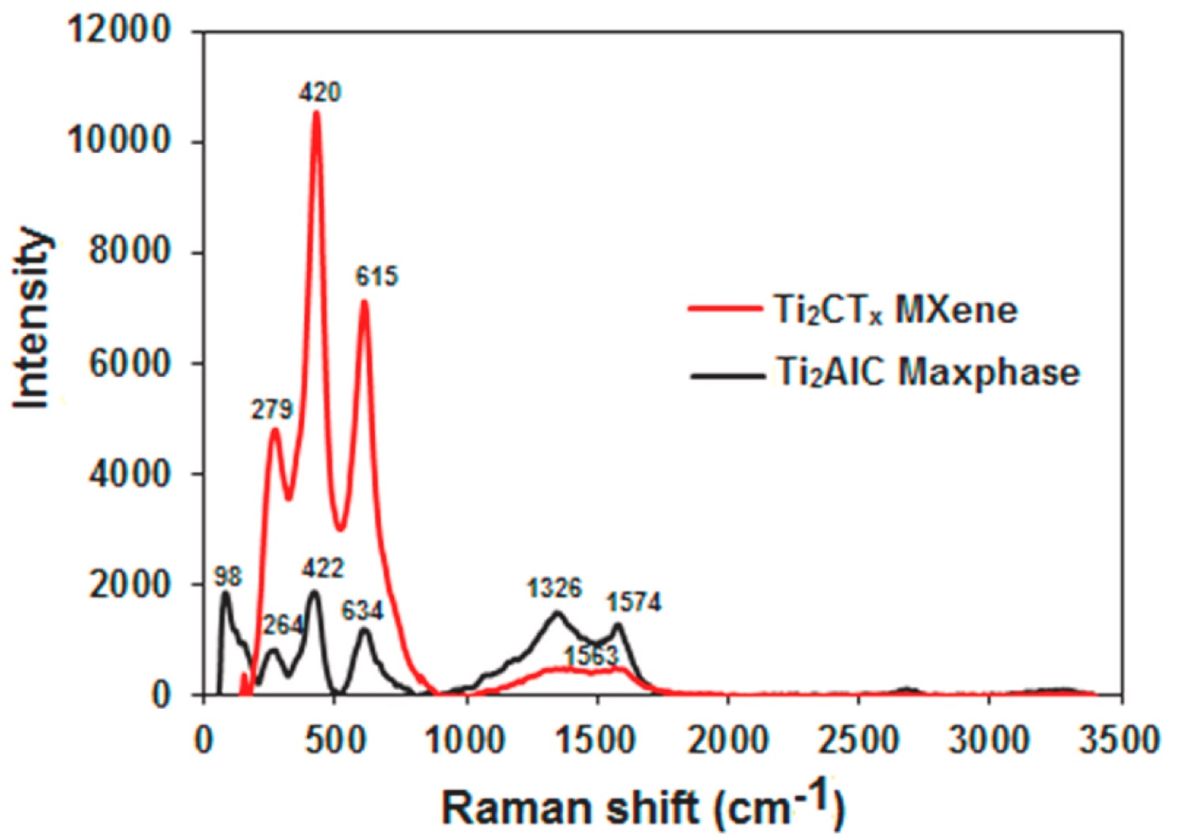
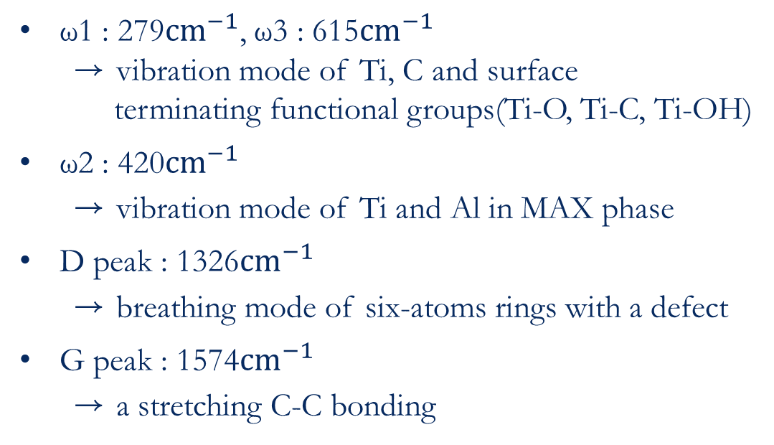
$${Ti}_{2}CT_{x}$$
ω2
ω1 : 279${cm}^{−1}$, ω3 : 615${cm}^{−1}$
→ vibration mode of Ti, C and surface
terminating functional groups(Ti-O, Ti-C, Ti-OH)
ω2 : 420${cm}^{−1}$
→ vibration mode of Ti and Al in MAX phase
D peak : 1326${cm}^{−1}$
→ breathing mode of six-atoms rings with a defect
G peak : 1574${cm}^{−1}$
→ a stretching C-C bonding
ω3
ω1
D
G

Slide 13
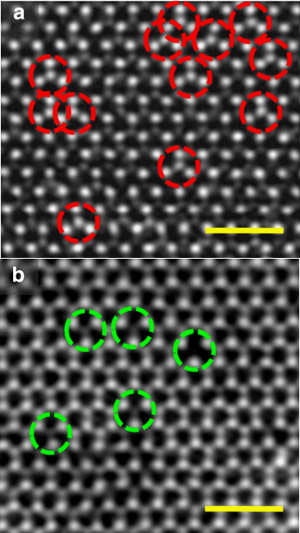
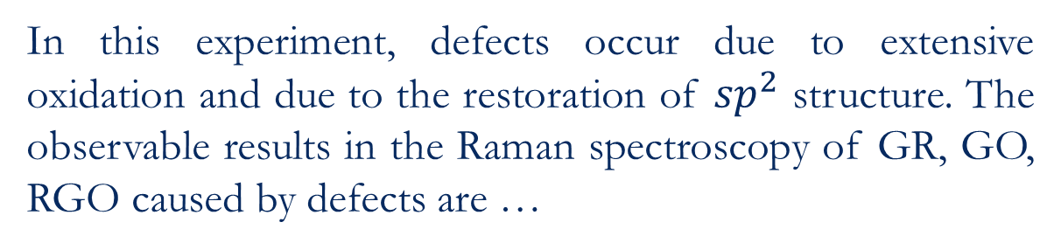
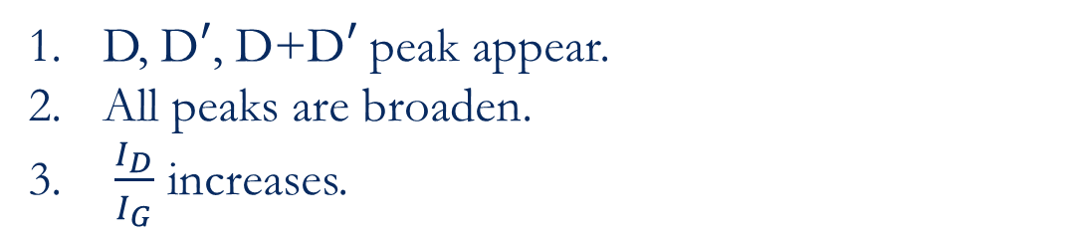
Defects
(Crystallographic) Defects are…
all the interruptions of regular patterns in crystalline solids.
In this experiment, defects occur due to extensive oxidation and due to the restoration of ${sp}^{2}$ structure. The observable results in the Raman spectroscopy of GR, GO, RGO caused by defects are …
D, D$′$, D+D$′$ peak appear.
All peaks are broaden.
$\frac{I_{D}}{I_{G}}$ increases.

Slide 14
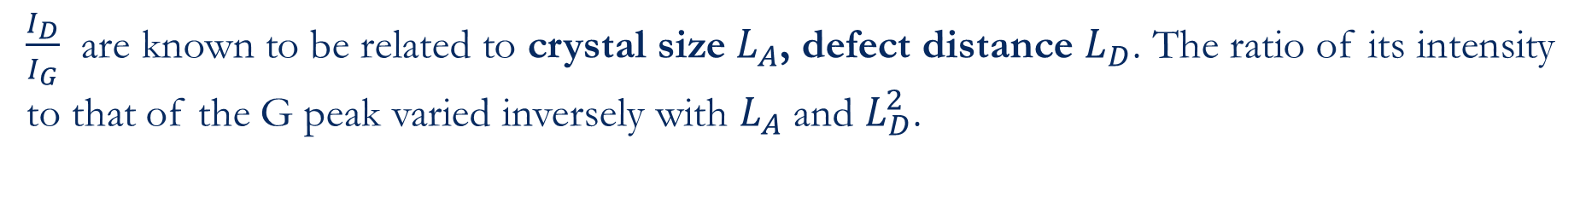
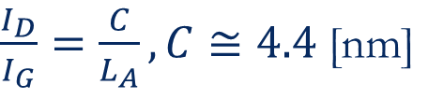
Defects and Crystal Size
$\frac{I_{D}}{I_{G}}$ are known to be related to crystal size $L_{A}$, defect distance $L_{D}$. The ratio of its intensity to that of the G peak varied inversely with $L_{A}$ and $L_{D}^{2}$.
$\frac{I_{D}}{I_{G}}=\frac{C}{L_{A}}, C≅4.4$[nm]

Slide 15
Conclusion

Slide 16
References
[1] Ferrari, A., Basko, D. Raman spectroscopy as a versatile tool for studying the properties of graphene. Nature Nanotech 8, 235–246 (2013)
[2] Lim, Gim Pao et al. “Synthesis, characterization and biophysical evaluation of the 2D Ti2CTx MXene using 3D spheroid-type cultures.” Ceramics International (2021)
[3] Alhwaige, Almahdi A. et al. “Interactions, morphology and thermal stability of graphene-oxide reinforced polymer aerogels derived from star-like telechelic aldehyde-terminal benzoxazine resin.” RSC Advances 5 (2015)
[4] Hidayah, N. M. S. et al. “Comparison on graphite, graphene oxide and reduced graphene oxide: Synthesis and characterization.” (2017)
[5] Iqbal A, Hamdan NM. Investigation and Optimization of Mxene Functionalized Mesoporous Titania Films as Efficient Photoelectrodes. Materials. (2021)

Slide 17
Thank you

